Slide 1

Insurance Claim Prediction and Risk Analysis
Presented by Data Science Team — Date: June 2024

Slide 2

Executive Summary
Project Purpose
Benefits
Outcome
Predict insurance claims and detect potential fraud.
Supports risk management, fair pricing, and underwriting decisions.
Improved accuracy and operational efficiency in claims processing.

Slide 3
Problem Statement
Background
Objective
Scope
Insurers struggle to identify high-risk policyholders and fraudulent claims.
Predict claim filing and detect possible fraud using historical data.
Binary classification for claims plus fraud risk assessment based on key features.

Slide 4
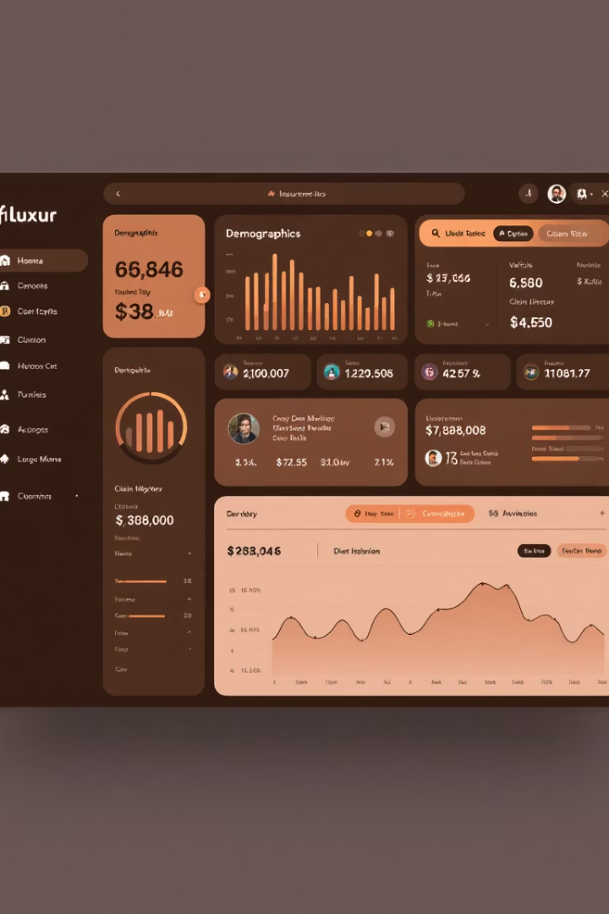
Data Sources
Primary Data
Insurance dataset: demographics, vehicle, policy details, and claims history.
Secondary Data
Industry reports and public datasets for benchmarking and validation.

Slide 5





Methodology
Data Preparation
Clean, encode, scale, and engineer features including fraud indicators.
Exploratory Analysis
Analyze feature distributions, outliers, and correlations.
Modeling
Logistic Regression
Decision Tree
Random Forest
XGBoost
Evaluation
Use Accuracy, Precision, Recall, F1-Score, ROC-AUC metrics.

Slide 6
Results and Insights
Model Comparison
Key Features
Risk Scores
XGBoost performs best on claim and fraud prediction.
Policyholder age, vehicle type, claim history
Probabilities inform claim likelihood and fraud risk prioritization.
Fraud-related flags and anomaly scores

Slide 7

Business Impact
Fraud Detection
Premium Pricing
Improved identification reduces false claims and losses.
Better risk segmentation supports fair and competitive pricing.
Underwriting
Data-driven decisions enhance operational efficiency and accuracy.

Slide 8

Risks, Challenges, and Conclusion
1
Key Risks
Class imbalance and data quality issues.
Evolving fraud tactics challenge model accuracy.
Regulatory demands for model explainability.
2
Conclusion
ML models enhance claim prediction and fraud detection.
Data-driven strategies improve insurance risk management and profitability.

